Slide 1
Tracking maternal health progress toward sdg 3.1
IBM EDUNET PROJECT
Presented By:
1.Roshan Kumar– CSE Department, Haridwar University

Slide 2
OUTLINE
Problem Statement
Proposed System/Solution
System Development Approach
Algorithm & Deployment
Result
Conclusion
Future Scope
References

Slide 3
Problem Statement
Sustainable Development Goal SDG 3.1 aims to reduce the global maternal mortality ratio (MMR) to less than 70 per 100,000 live births by 2030.
Despite continuous global health initiatives, maternal mortality remains highly uneven across countries and income groups. Many developing nations continue to face high maternal death rates due to gaps in healthcare access, lack of skilled birth attendants, adolescent pregnancies, and insufficient healthcare funding.
Monitoring progress toward SDG 3.1 requires analyzing multiple health indicators simultaneously, including:
Maternal Mortality Ratio (MMR)
Antenatal Care Coverage
Births Attended by Skilled Health Personnel
Adolescent Birth Rate
Healthcare Expenditure
However, the available data is scattered, complex, and difficult to interpret without proper analytics.
The challenge:
To perform data-driven analysis that identifies patterns, trends, and key factors influencing maternal health outcomes across countries.

Slide 4
Proposed Solution
System Components
1. Data Collection
AI Kosh SDG National Indicator Framework dataset:
Maternal mortality statistics
Healthcare infrastructure indicators
Demographic & expenditure data
2. Data Preprocessing
Handle missing & inconsistent values
Filter key maternal health indicators
Standardize country/year formats
Create derived metrics
3. Data Analysis & Visualization
Year-wise trend analysis
Country & regional comparisons
Indicator correlation analysis
Dashboard visualizations
4. Cloud Deployment
Implemented using IBM Cloud Lite for scalable data analysis.

Slide 5
System Approach
Cloud Platform
IBM Cloud Lite
Category | Technology
Cloud Platform | IBM Cloud Lite
Data Analysis | Python
Data Processing | Pandas, NumPy
Visualization | Matplotlib, Seaborn
Notebook Environment | IBM Watson Studio
Dataset Source | Data.gov.in SDG Dataset
Why IBM Cloud?
Free cloud resources for students
Integrated data science tools
Easy deployment and scalability
Notebook-based development environment

Slide 6
Algorithm & Deployment
Approach
Exploratory Data Analysis (EDA) + Statistical Correlation Modeling
Focus: policy insights, trend tracking, indicator relationships
Key Methods
Trend Analysis: Year-wise MMR changes, regional comparisons
Correlation (Pearson):
  Skilled birth attendance ↔ MMR
  Antenatal care ↔ MMR
  Healthcare expenditure ↔ MMR
  Adolescent birth rate ↔ MMR
Visualizations: Line charts, bar charts, heatmaps, scatter plots
IBM Cloud Deployment
IBM Cloud Lite account → Watson Studio
Project workspace created
Dataset uploaded
Analysis executed in Jupyter Notebook
Visual results generated

Slide 7
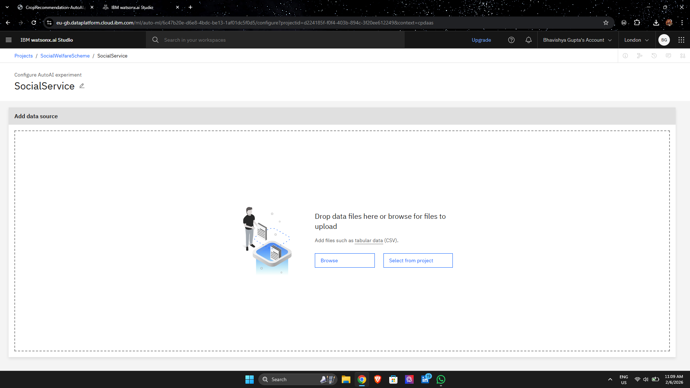
Result

Slide 8
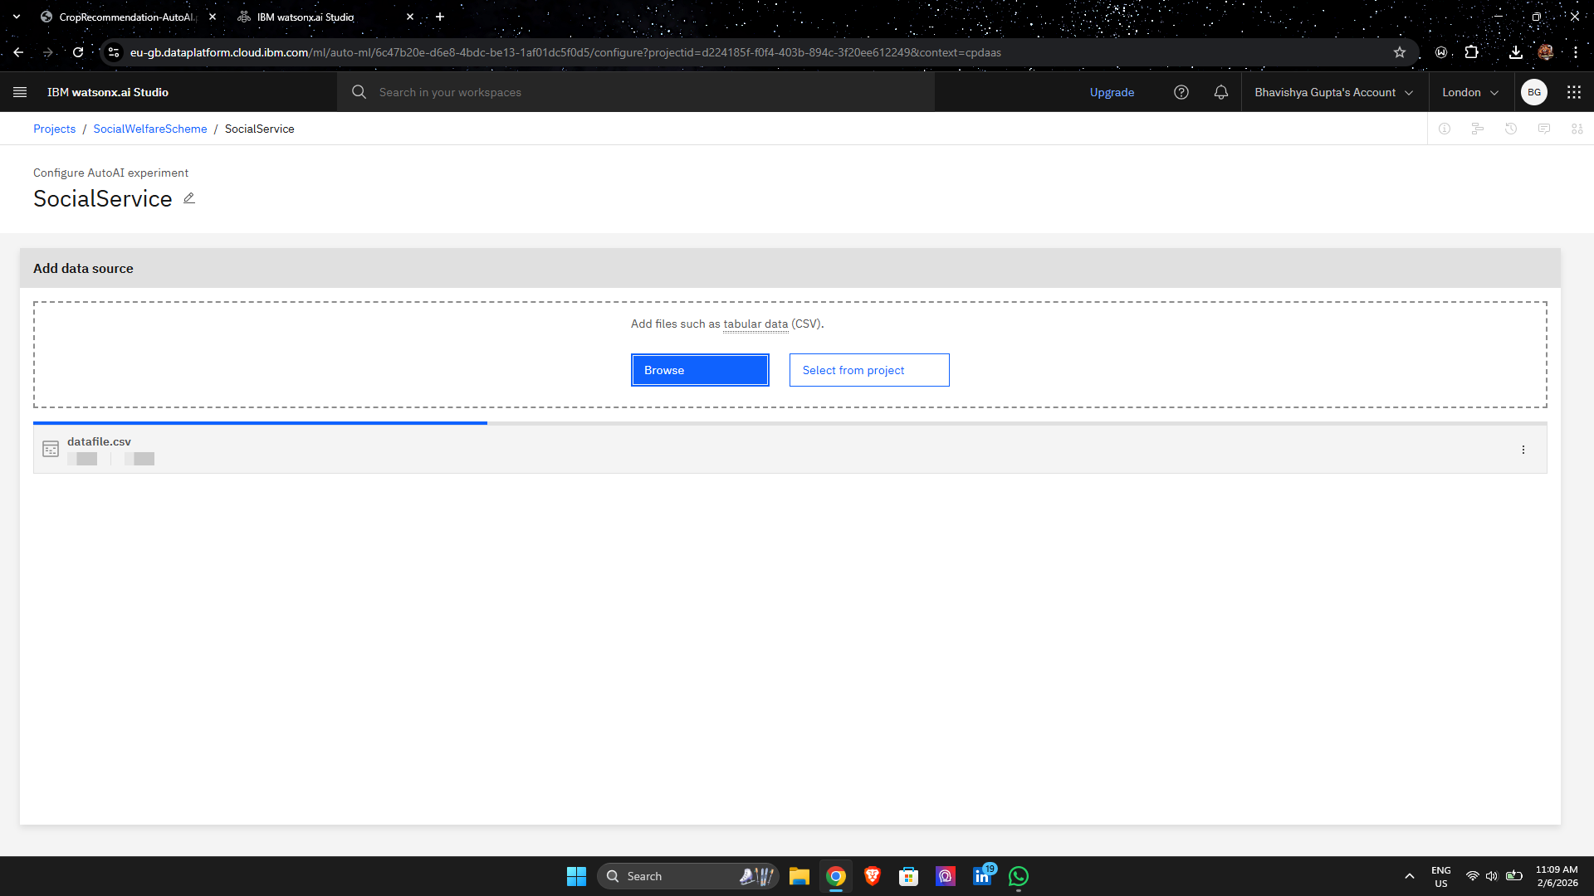
Result

Slide 9
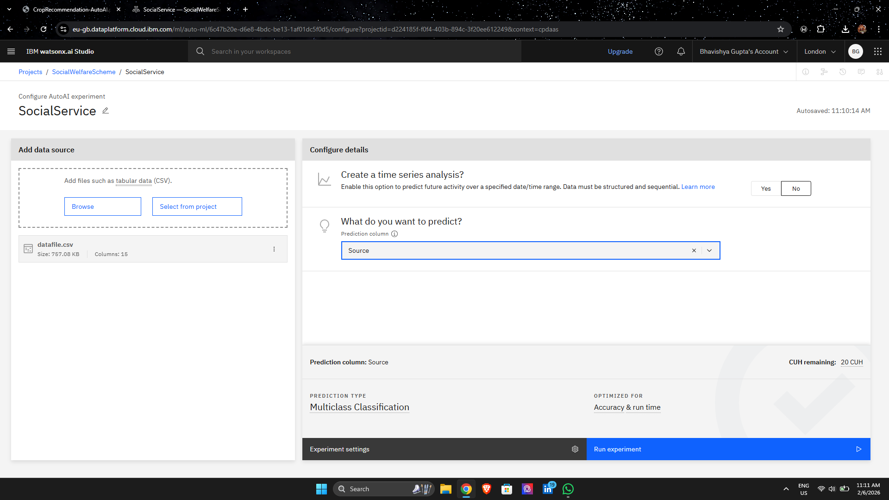
Result

Slide 10
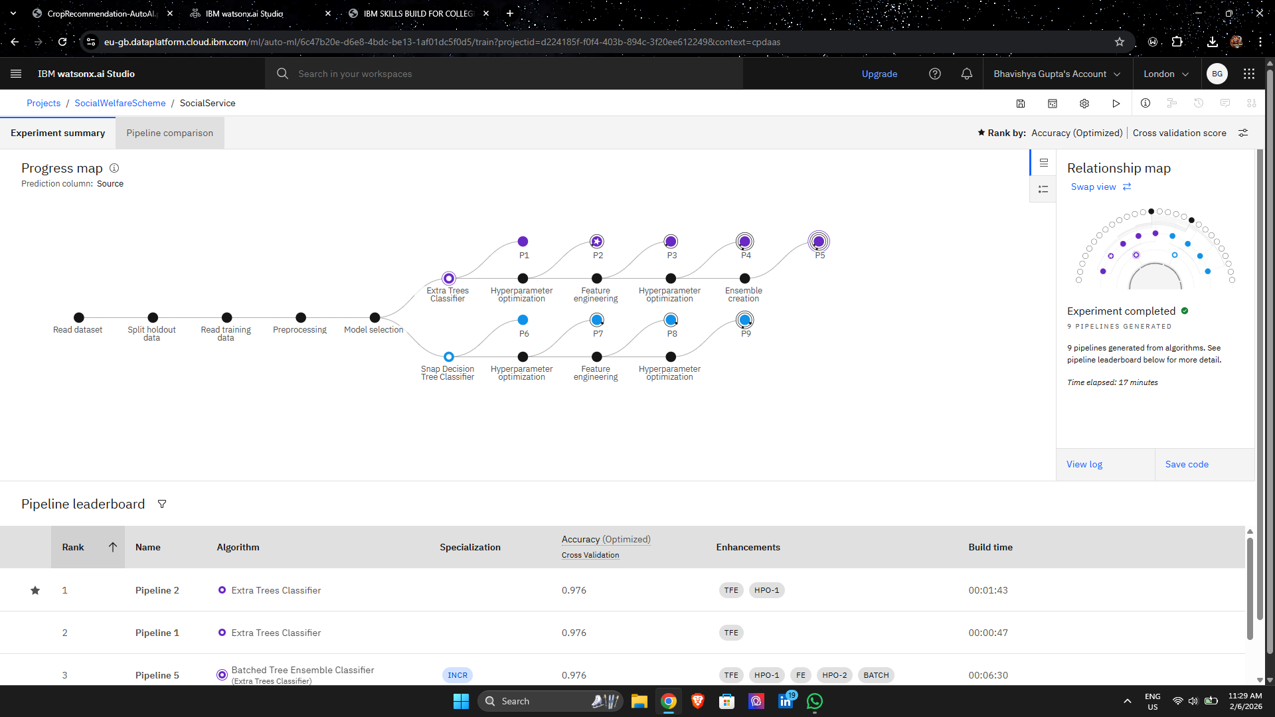
Result

Slide 11
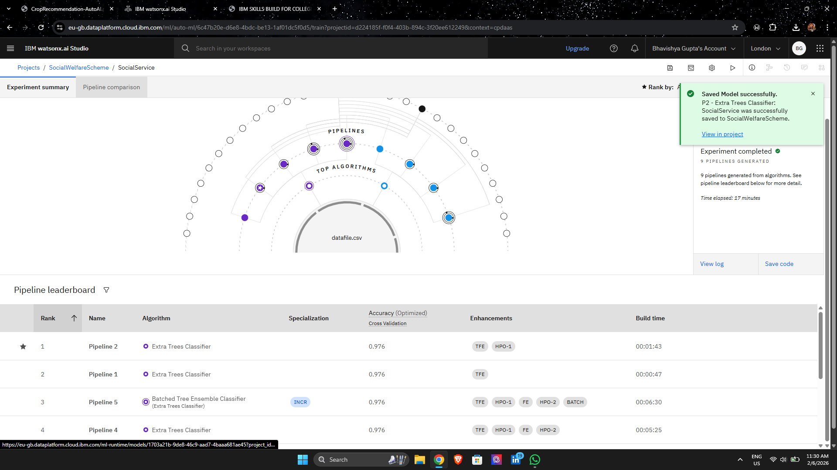
Result

Slide 12
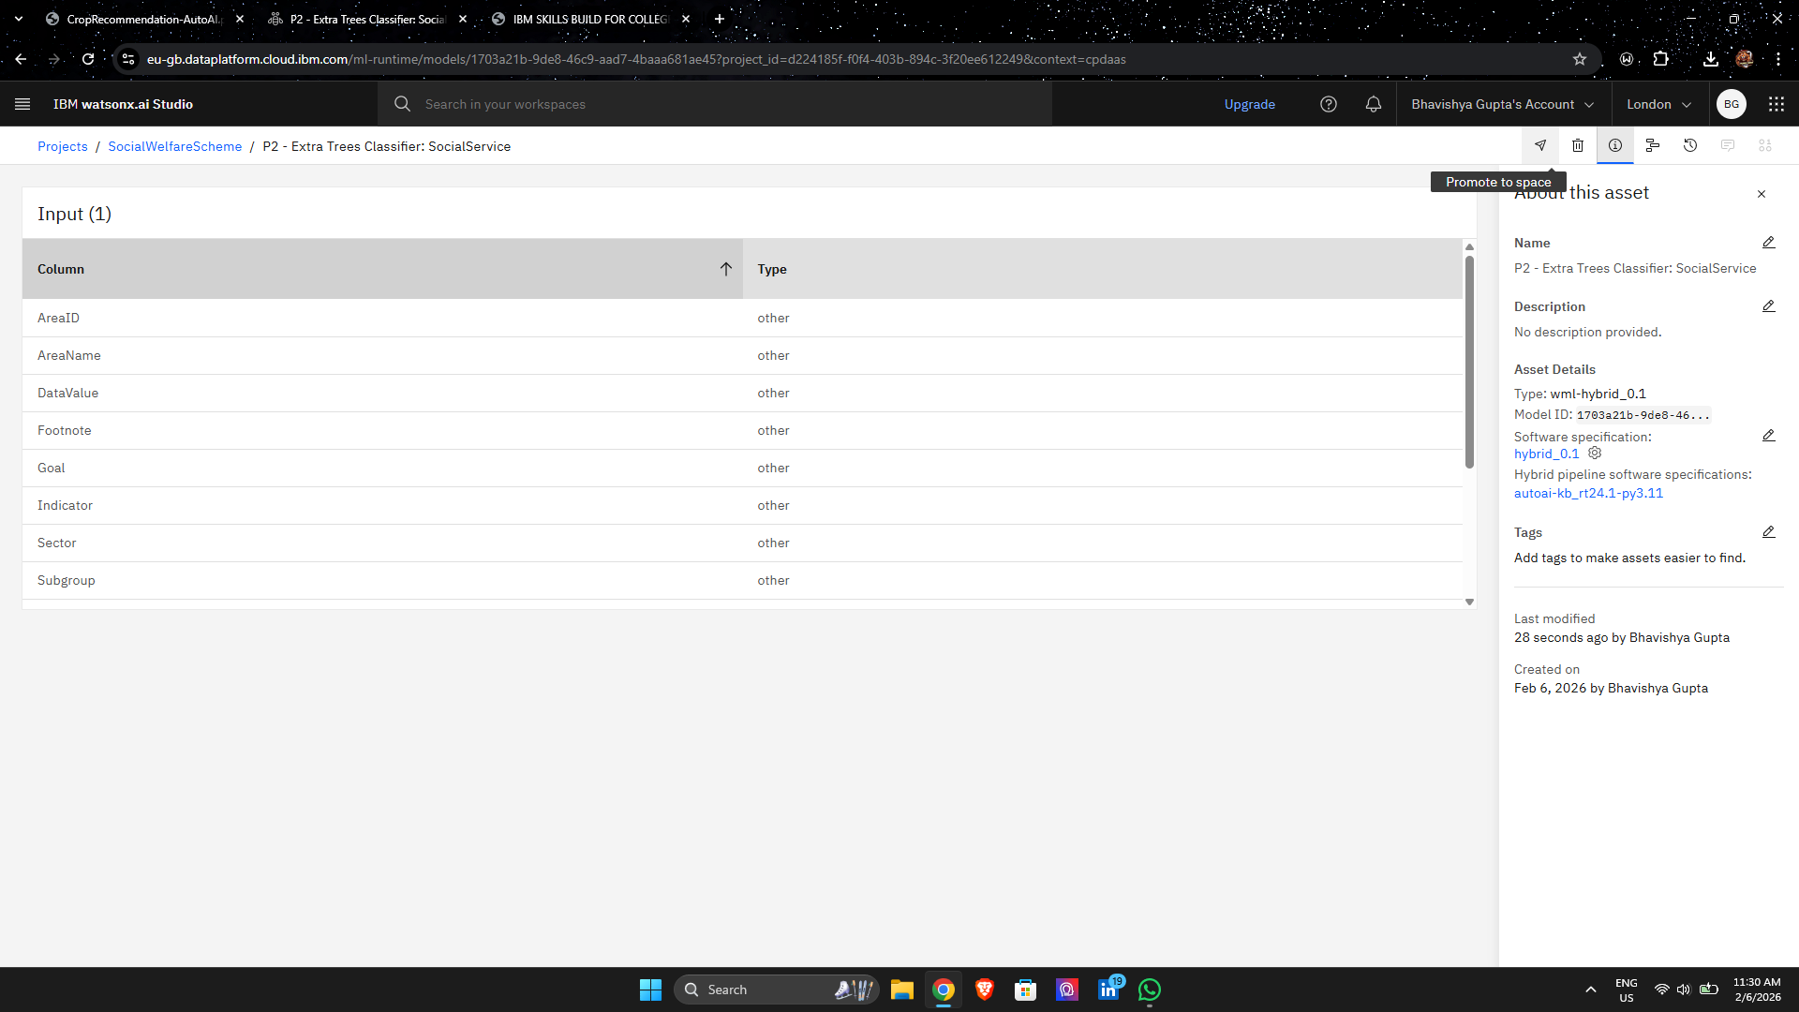
Result

Slide 13
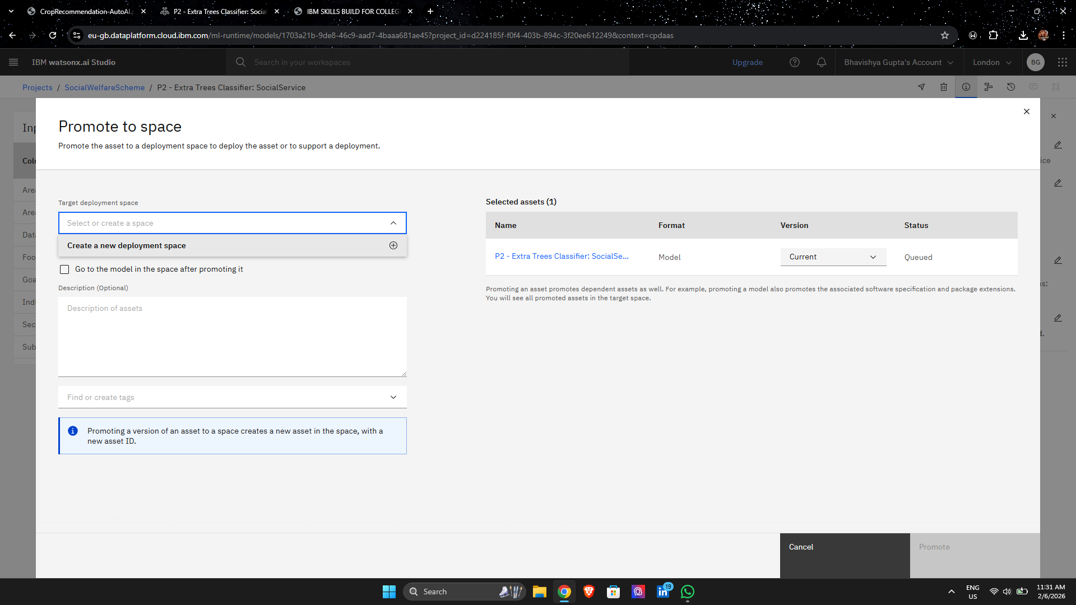
Result

Slide 14
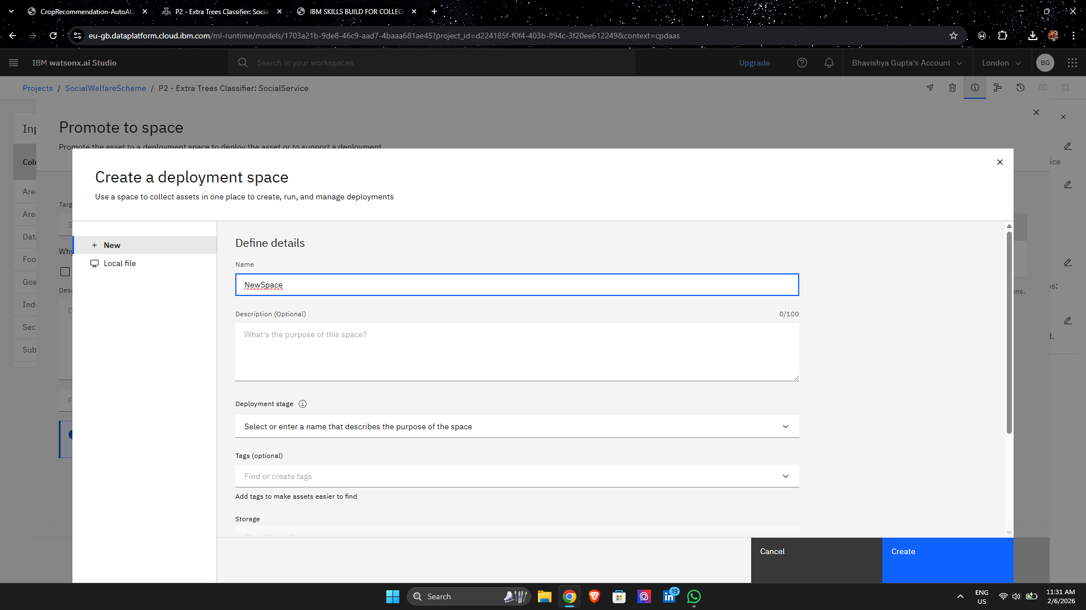
Result

Slide 15
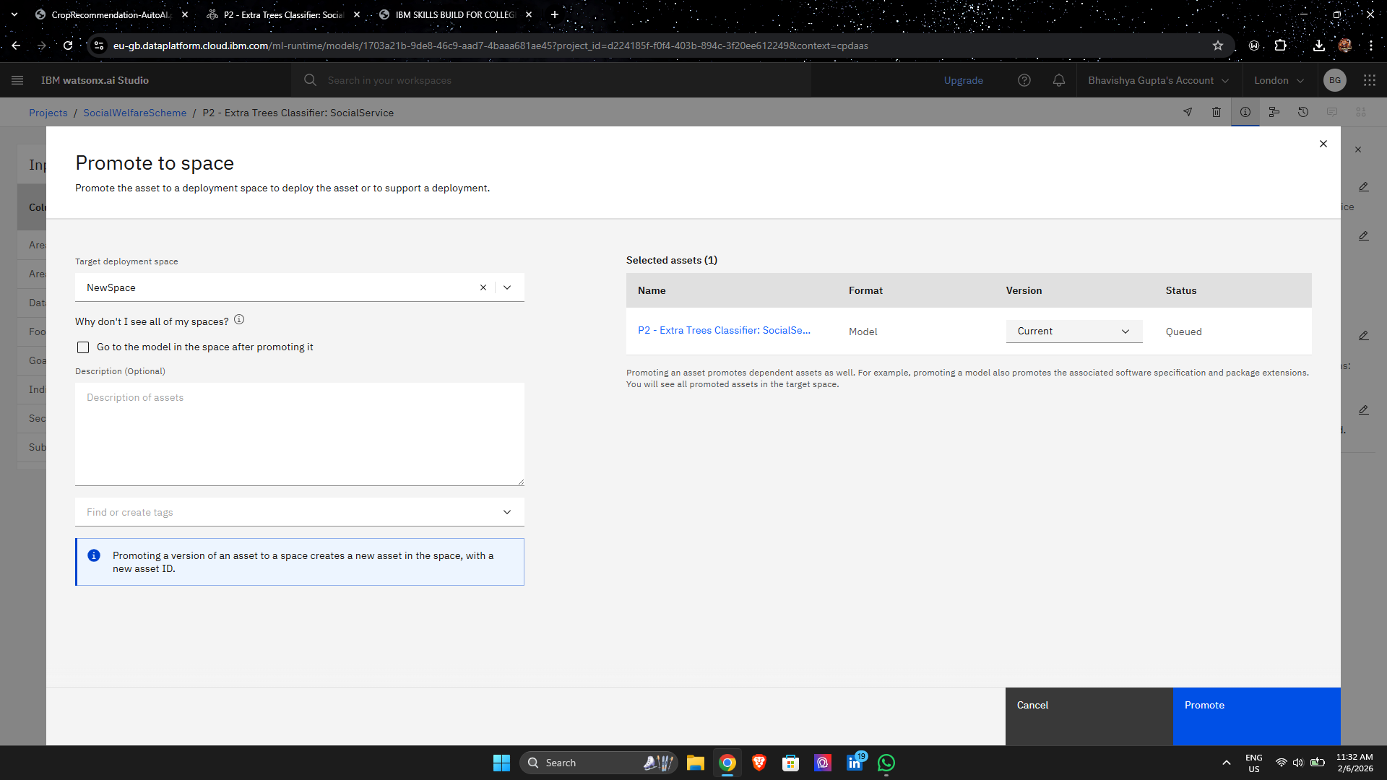
Result

Slide 16
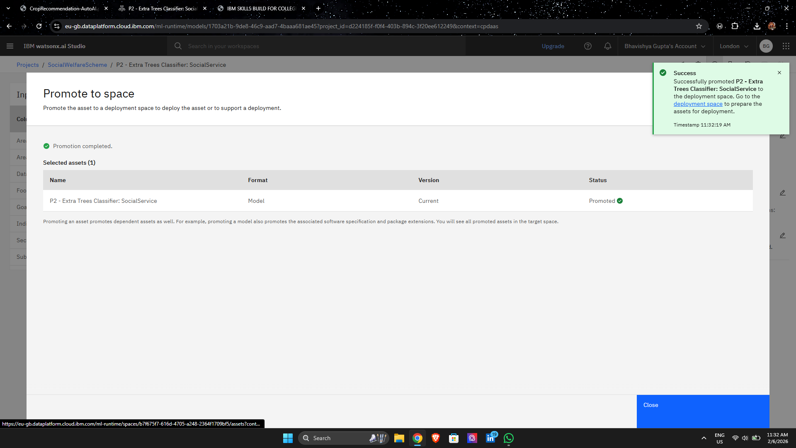
Result

Slide 17
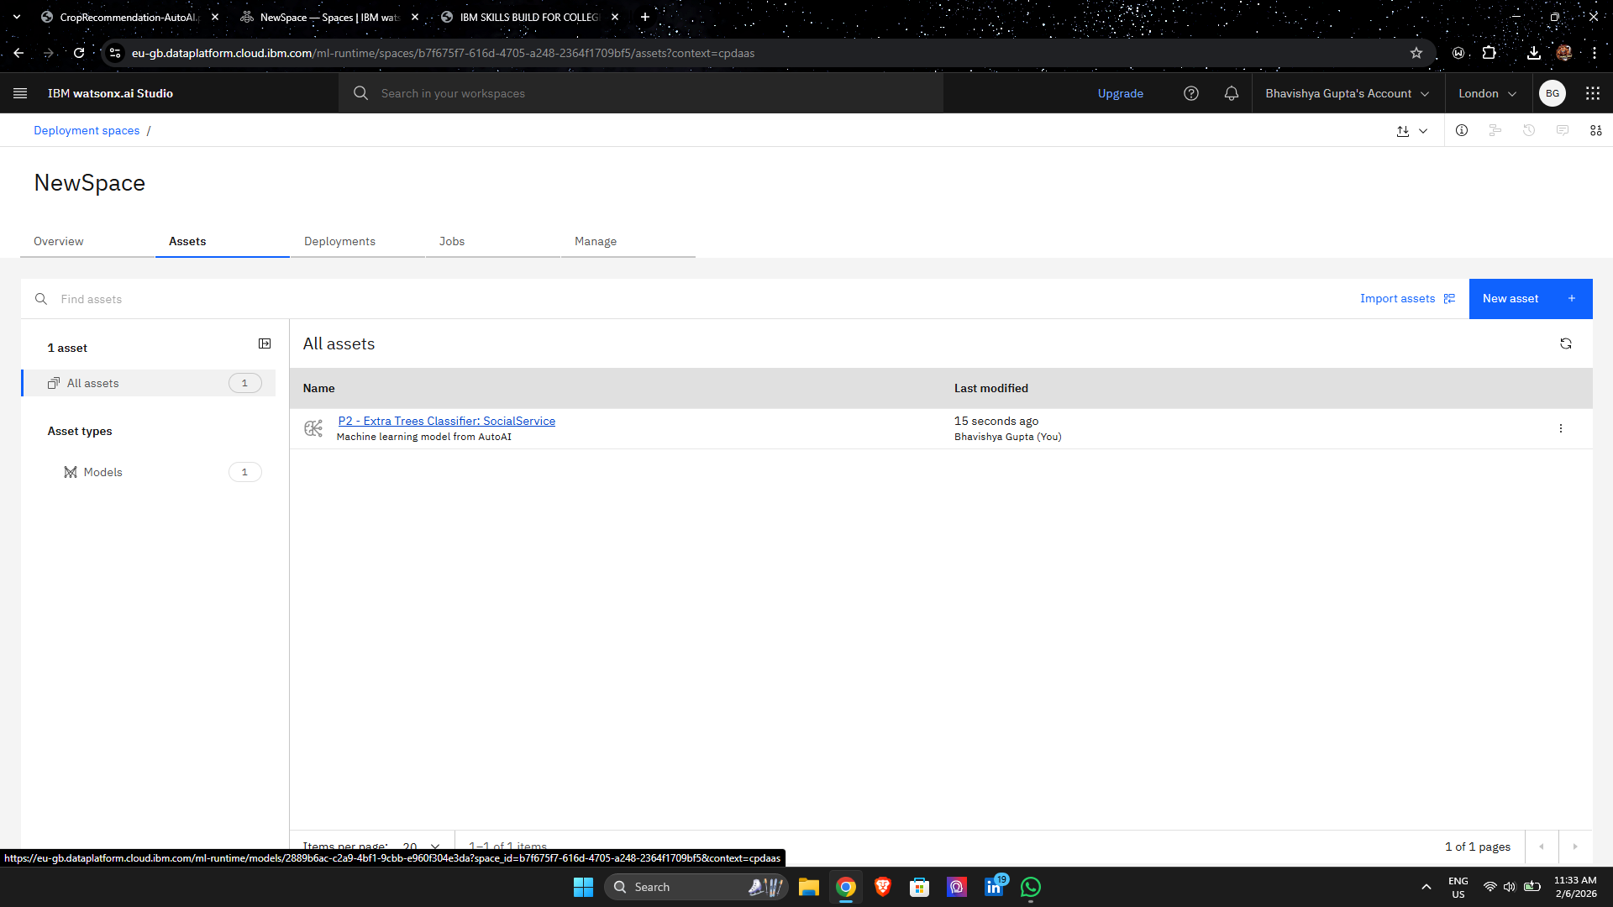
Result

Slide 18
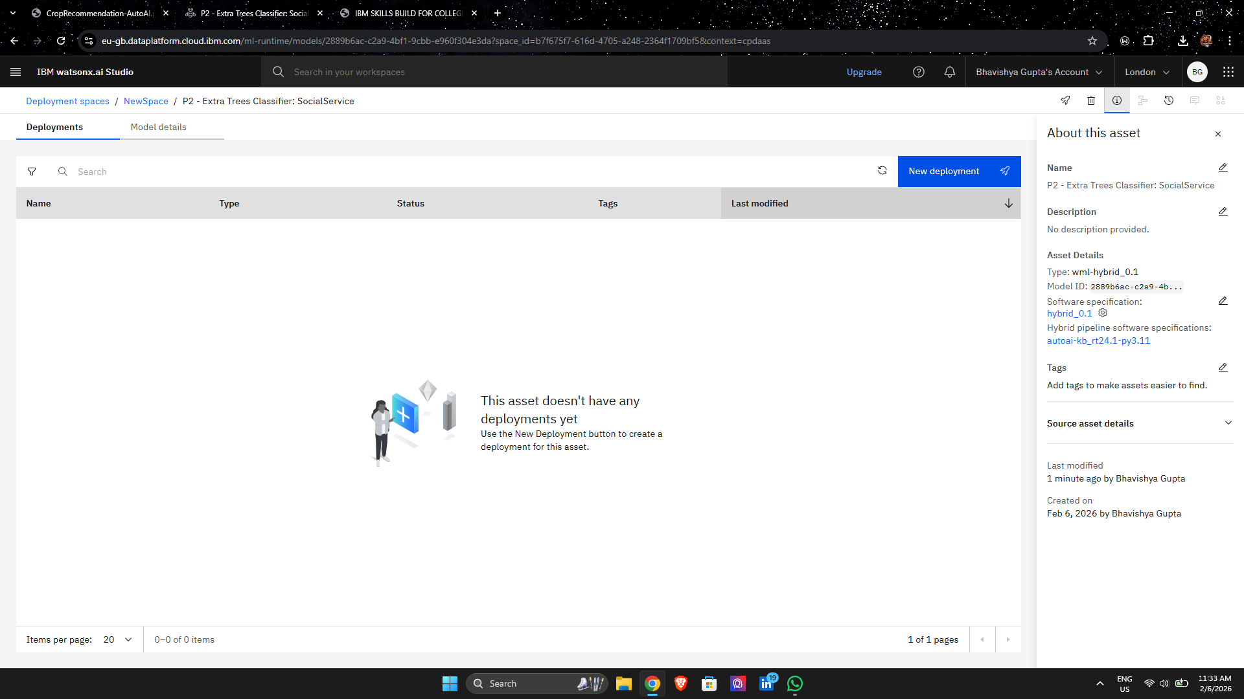
Result

Slide 19
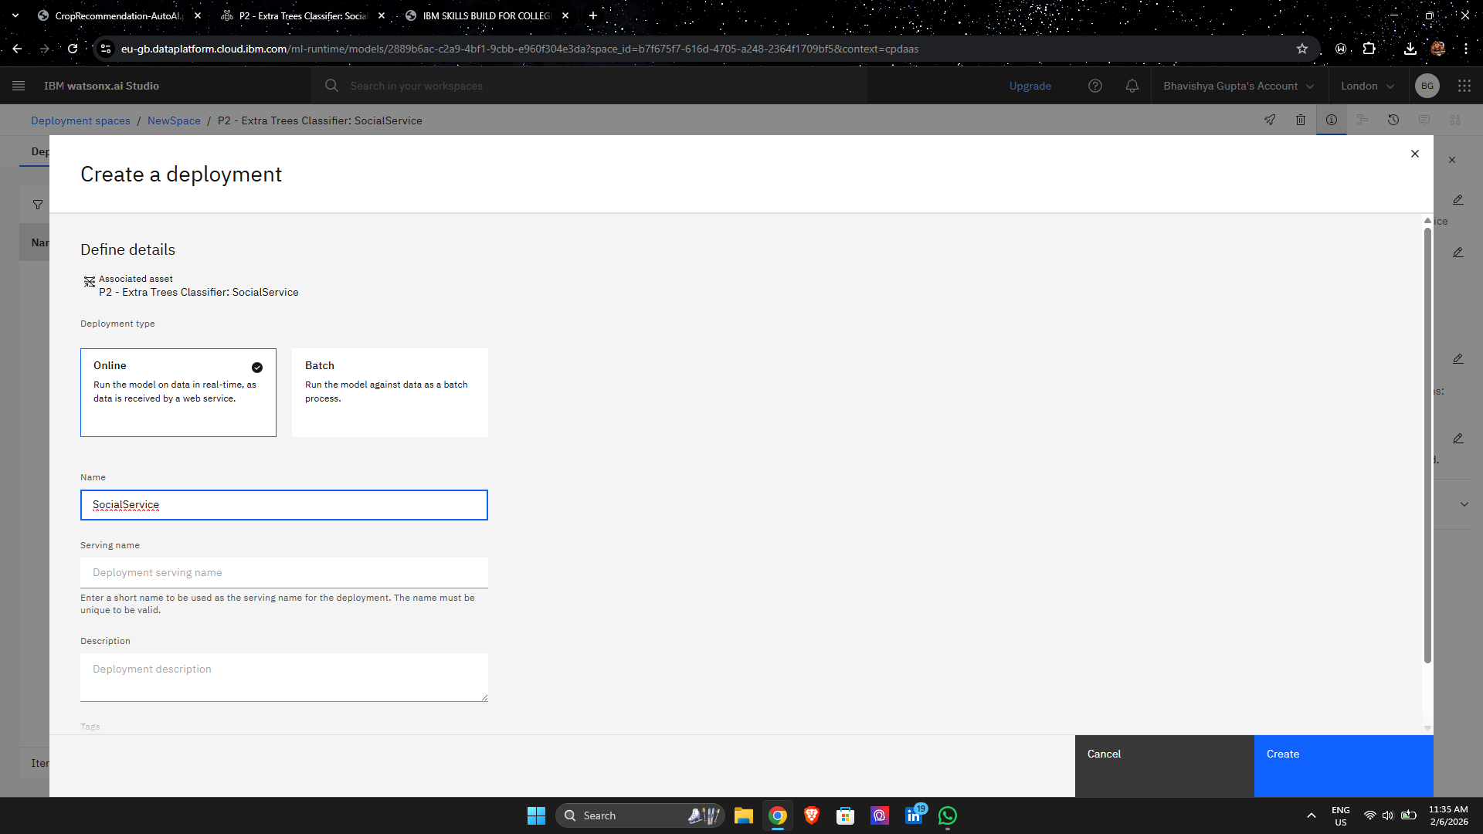
Result

Slide 20
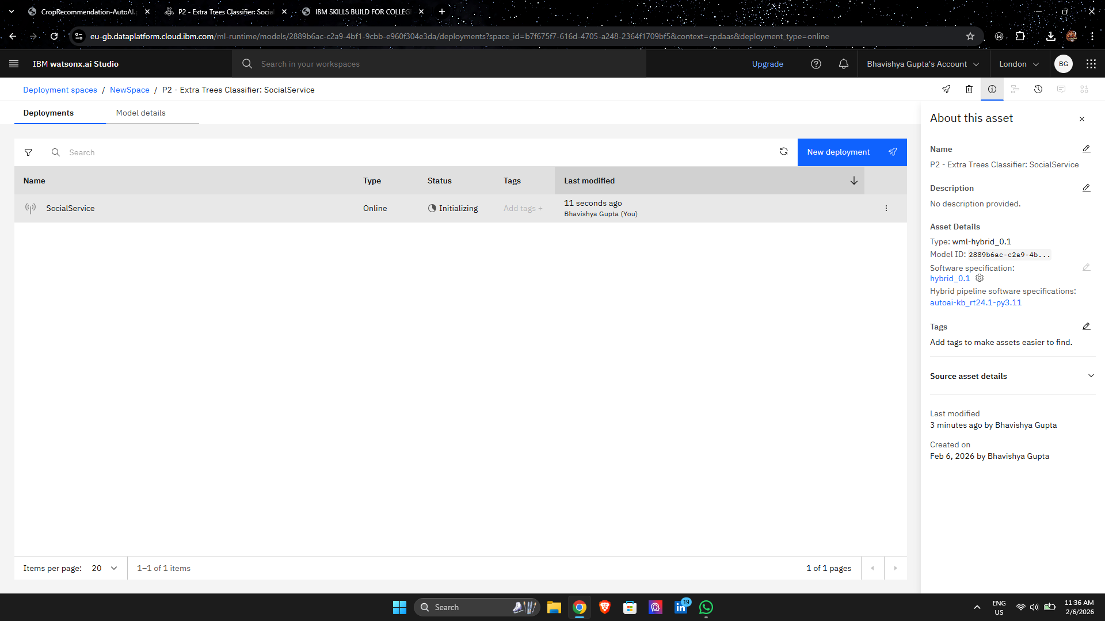
Result

Slide 21
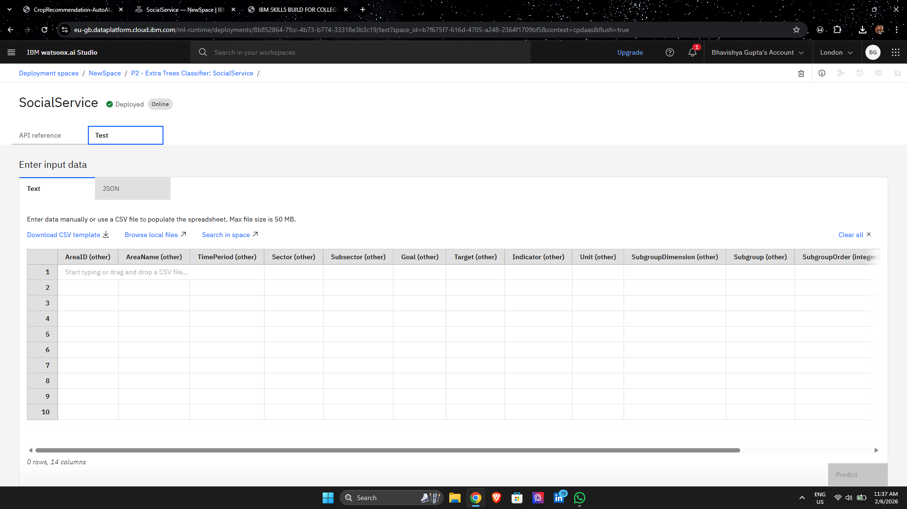
Result

Slide 22
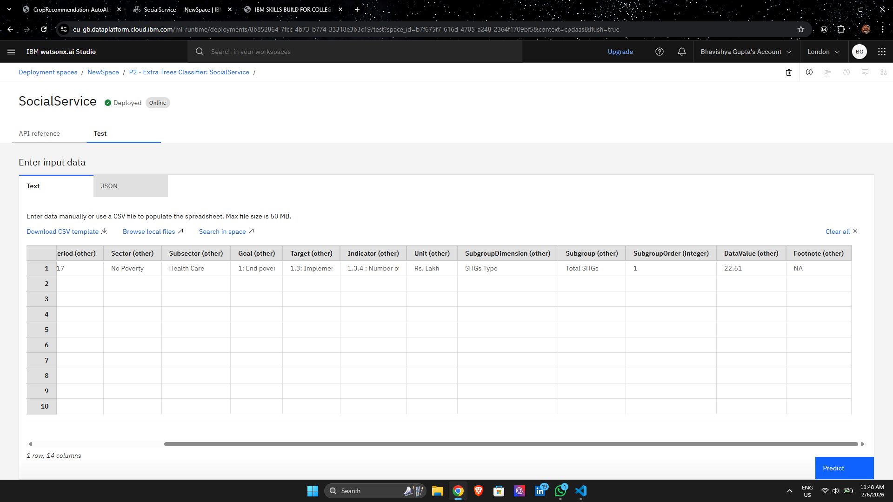
Result

Slide 23
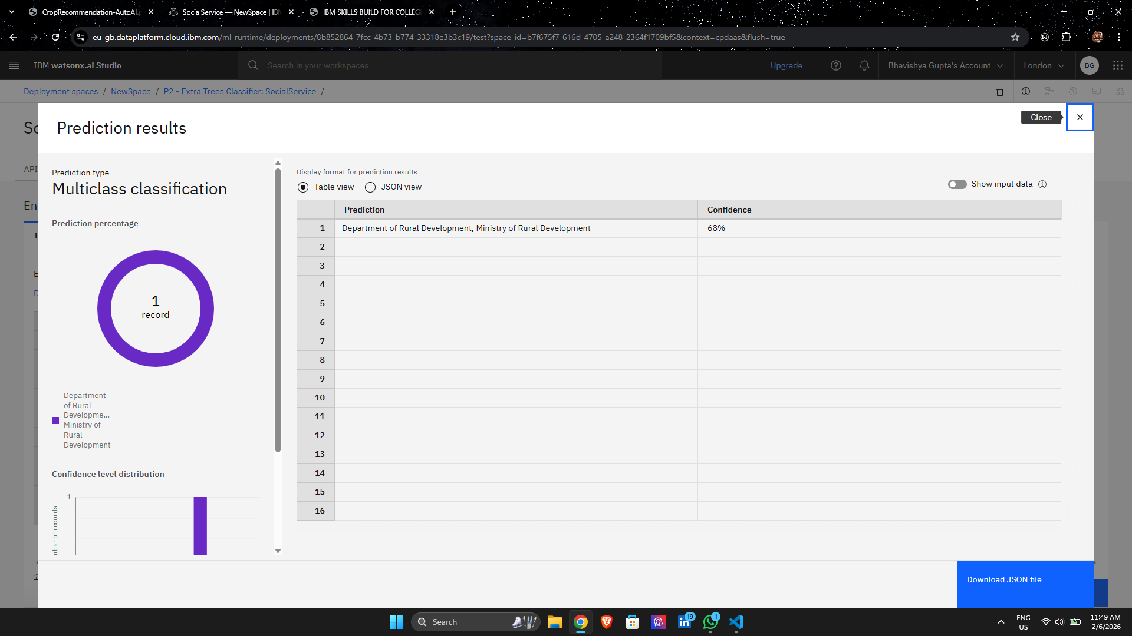
Result

Slide 24
Github link
https://github.com/roshankr2409/ibm-PROJECT/upload/main

Slide 25
Future scope
Possible improvements:
Build predictive models for future MMR trends
Create interactive dashboards using IBM Cognos
Expand dataset with WHO and World Bank data
Develop real-time policy monitoring tools
Integrate AI forecasting models

Slide 26
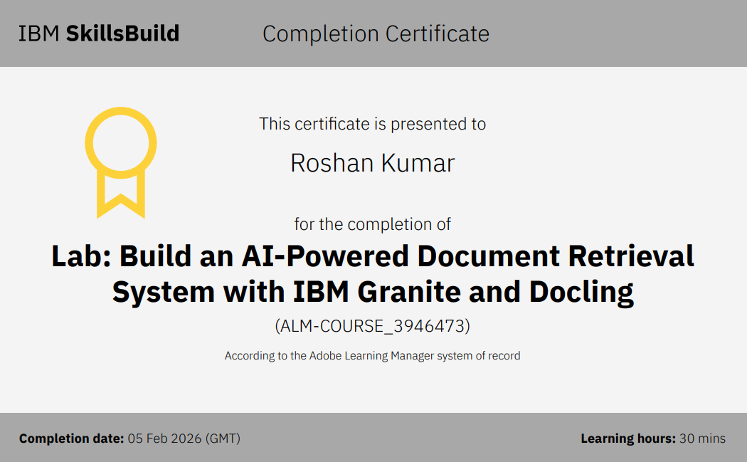
IBM Certification

Slide 27
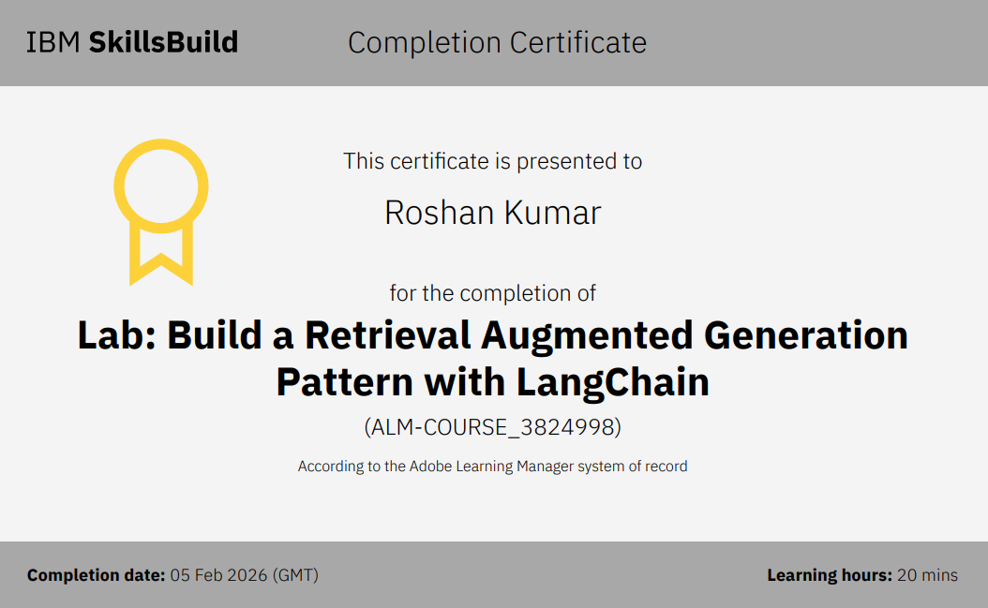
IBM Certification

Slide 28
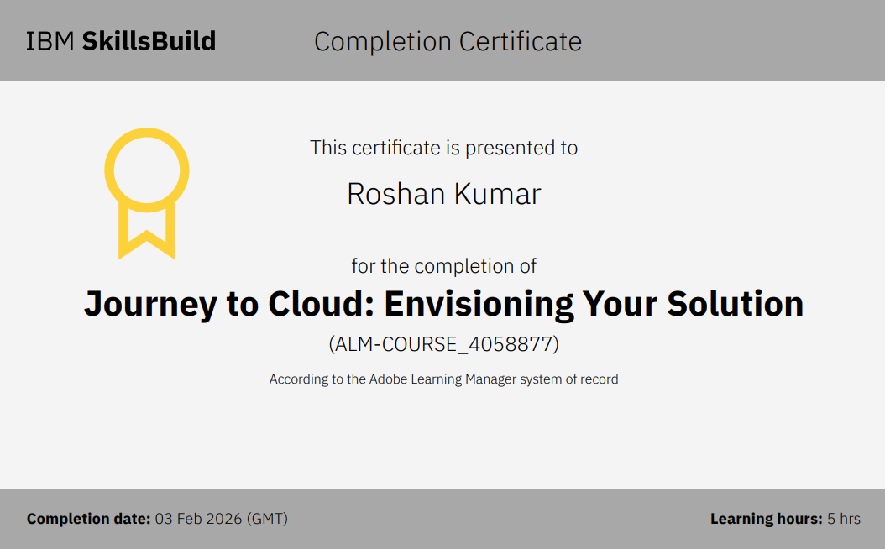
IBM Certification

Slide 29
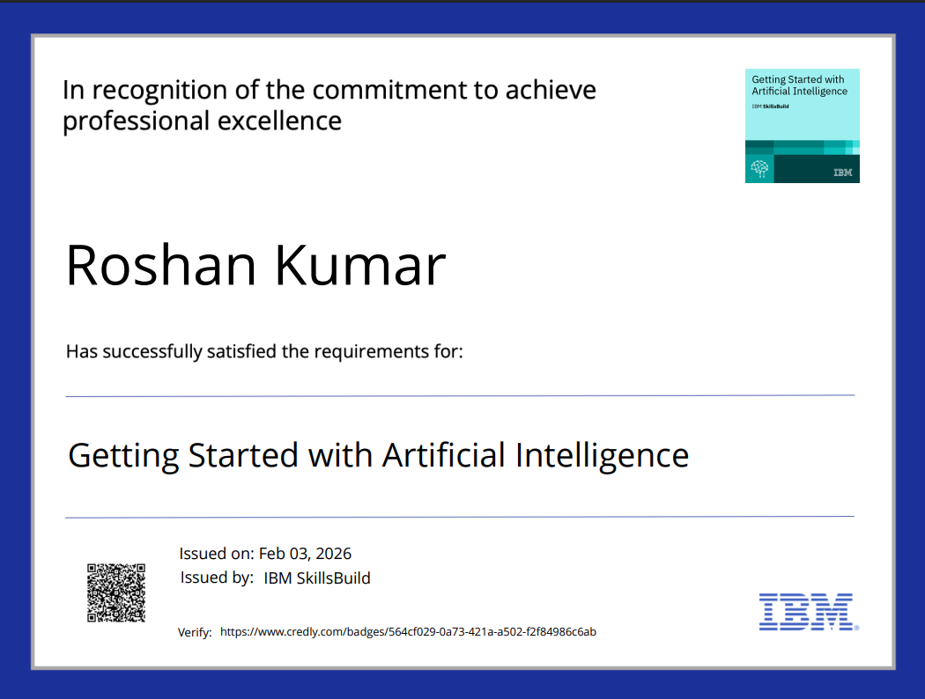
IBM Certification

Slide 30
Conclusion
This project successfully analyzed global maternal health indicators to evaluate progress toward SDG 3.1.
Key Findings
Maternal mortality is strongly linked to healthcare access and funding
Skilled birth attendance is one of the most critical life-saving factors
Developing countries still face major challenges
Data analytics provides valuable insights for policymaking
The system demonstrates how cloud-based analytics can support public health monitoring and global development goals.

Slide 31
References
watsonx.ai Studio
cloud.ibm.com
Credly
IBM Skills Build
IBM Granite

Slide 32
THANK YOU

